Slide 1

Data Science Committee
Session 2 - Introduction to Statistics
Prepared by: Ashraf Abdulkhaliq

Slide 2
Outline
What is Statistics?
Importance of statistics in data science
Types of data

Slide 3
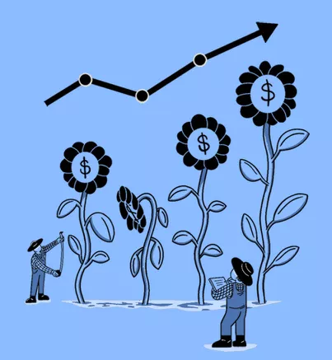
What is Statistics
Statistics is the study and manipulation of data, including ways to gather, review, analyze, and draw conclusions from data.
The two major areas of statistics are descriptive and inferential statistics.
Several sampling techniques can be used to compile statistical data, including simple random, systematic, stratified, or cluster sampling.

Slide 4
Importance of statistics in data science
Avoid getting biased samples
Prevent overgeneralization
Wrong causality
Incorrect Analysis

Slide 5
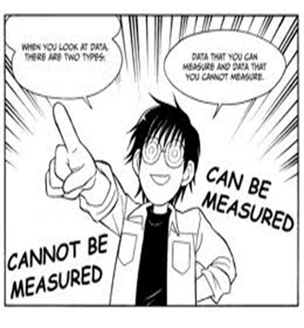
Types of data
Data is the collection of facts
Knowledge
Information
Data

Slide 6
Types of data (cont)
Data
Quantitative
Continuous
Discrete
Qualitative
Ordinal
Nominal
Can not be measured
Can be measured

Slide 7
Types of data (cont)
Data
Quantitative
Continuous
Discrete
Qualitative
Ordinal
Nominal
Can not be measured
Can be measured

Slide 8
Types of data (cont)
Qualitative Data
Quantitative Data
1. Nominal Data: Consists of categories or labels with no inherent order or ranking.
- Example:
Categories like blue, green, brown, and hazel represent nominal data.
Categories like apple, banana, orange, and grape are nominal data.
2. Ordinal Data: Categories with a natural order or ranking, but the differences between categories are not necessarily equal or well-defined.
- Example: Education Level: Categories like "high school," "bachelor's degree," "master's degree" represent ordinal data because they have a ranking but the difference in educational attainment between these categories is not uniform.
1. Continuous Data: Any value within a range and often involves measurements with infinite possibilities.
- Example:
Heights of individuals can vary within a continuous range, such as 162.5 cm, 173.2 cm, or 185.7 cm.
Temperature readings can have infinite decimal places, such as 23.5°C or 35.2°C.
2. Discrete Data: Discrete data consists of countable values that are typically whole numbers.
- Example:
Number of students in a classroom (e.g., 25, 30, 40) is a discrete.
Count of cars in a parking lot (e.g., 100, 150, 200) is discrete.

Slide 9
What is Statistics (cont)
Descriptive statistics
Focus on summarizing and describing the properties of sample and population data, including central tendency (mean, median, mode), variability (range, variance, standard deviation), and distribution (shape of data). They help understand the characteristics of a dataset.
Inferential statistics
Used to draw conclusions about a population based on data from a sample. They assess the reliability of these conclusions and are used for generalizing to larger groups or making predictions.
Techniques like regression analysis and hypothesis testing are part of inferential statistics and determine the strength of relationships and statistical significance in data.

Slide 10
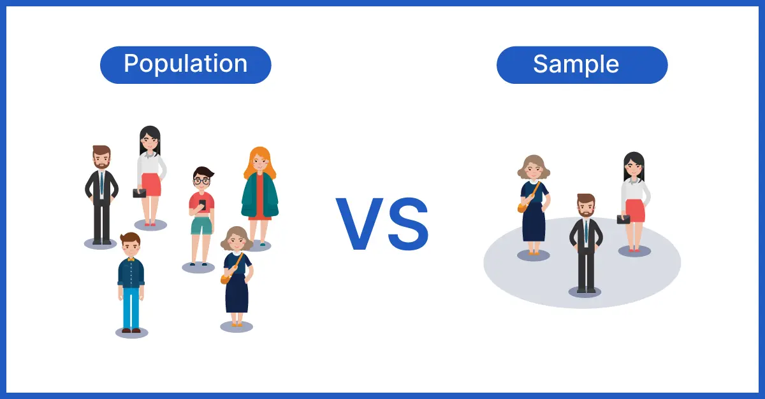

Slide 11
What is Statistics (cont)
Data: collection of facts

Slide 12
References
https://www.investopedia.com/terms/s/statistics.asp
https://www.voxco.com/blog/population-vs-sample/
https://studyonline.unsw.edu.au/blog/types-of-data

Slide 13
Thanks
Please keep updated:
https://github.com/kershrita/IEEE-Data-Science

